Slide 1
FYP presentation
Trajectory Optimisation for Target-in-range problems
Nikilesh Ramesh
16/05/2024

Slide 2
Overview
Meet the team
Our department
Our faculty
On campus
Our students
Any questions

Slide 3

Motivation

Slide 4
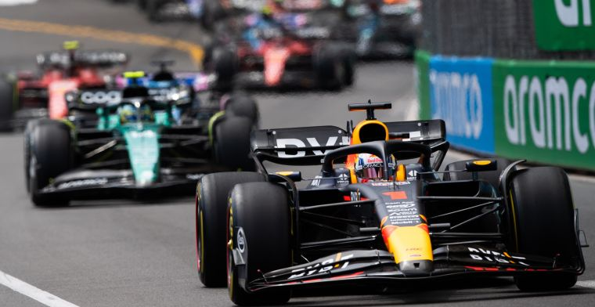
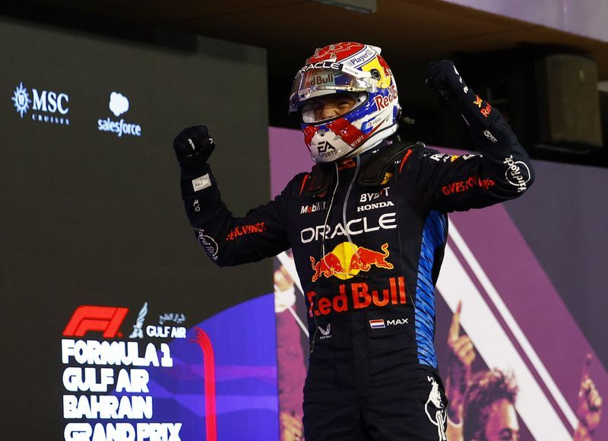
Motivation: Case Study (I)
Consider the case where a F1 race is being tracked with a single autonomous drone.
How do you choose the setpoint for tracking?
Do you choose the car in the mean position? No, fans more care about the winner.
So do you choose the car in the first position? Could do, but what if you got Max Verstappen in a RedBull car with a 20 second lead.

Slide 5
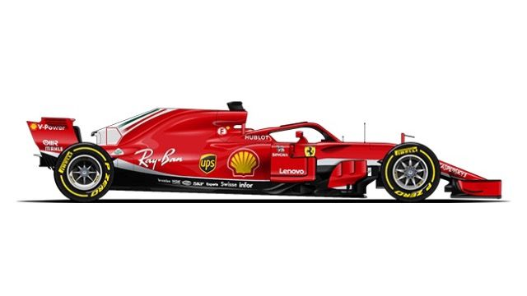
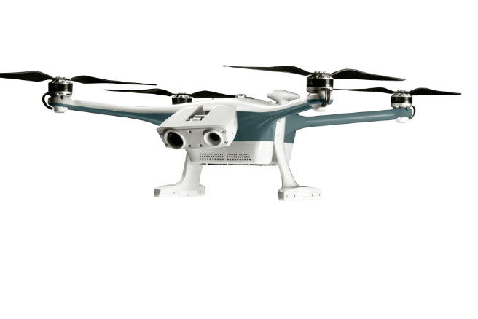
Motivation: Case Study (II)

Slide 6
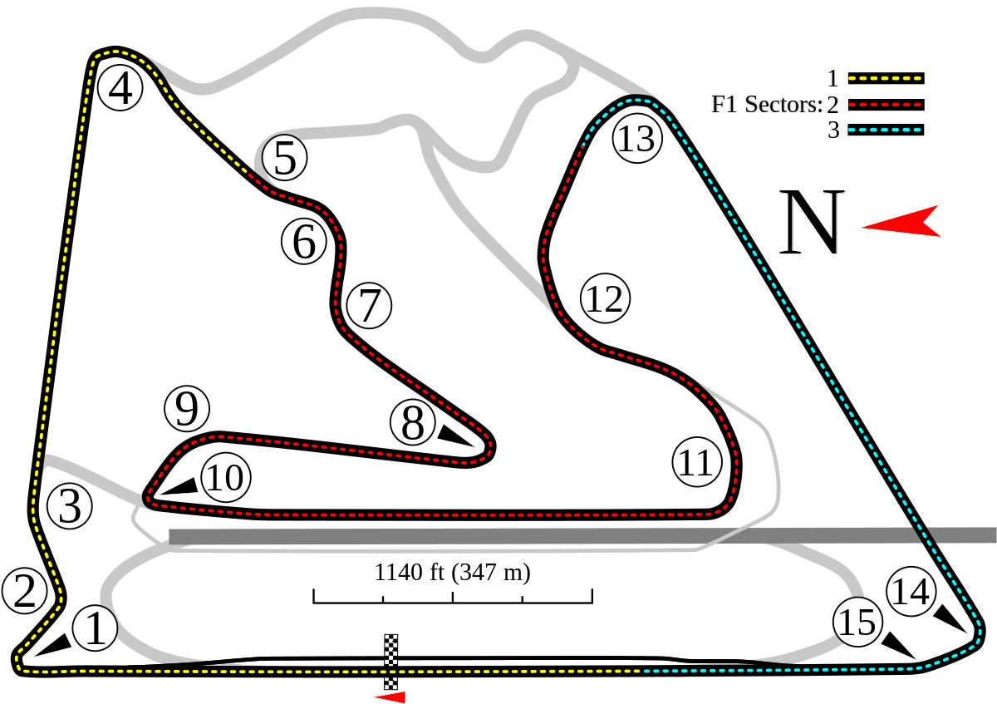
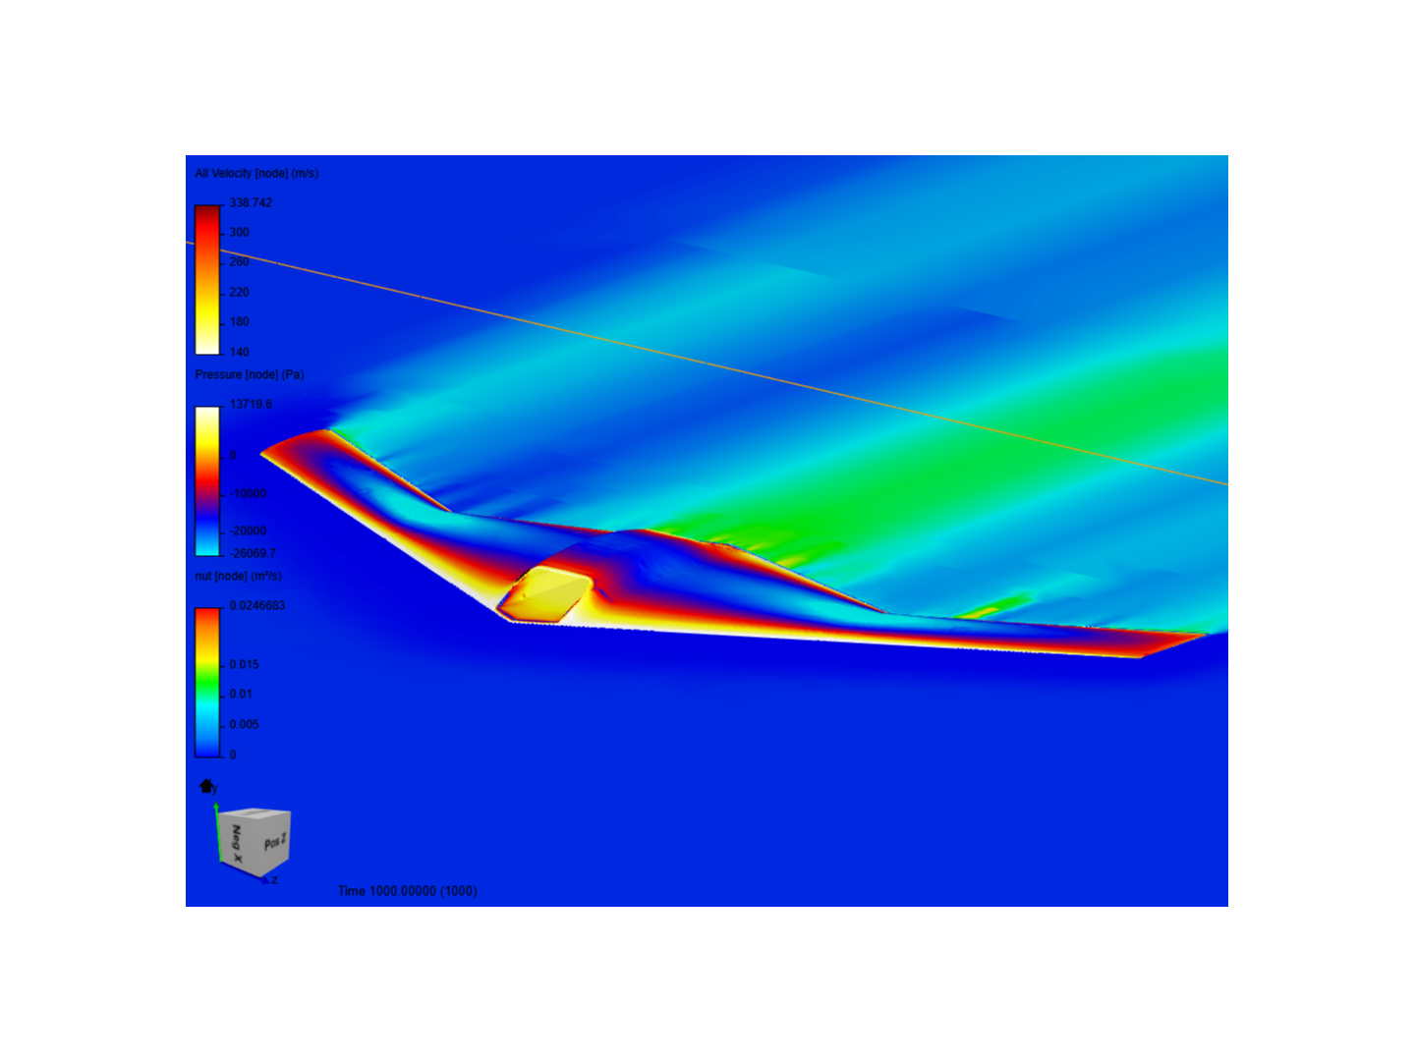
Motivation: Case Study (III)
Map of Bahrain GP.
Efficiency and Entertainment value vs tracking behavior.
UAV can explore more efficient paths if not constrained by the tracking behavior.
NOTE: The most efficient path between two points may not be a straight line cause of physics of the tracker.

Slide 7
Background

Slide 8
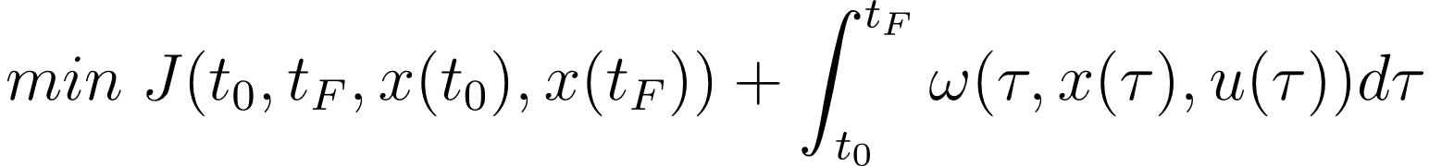
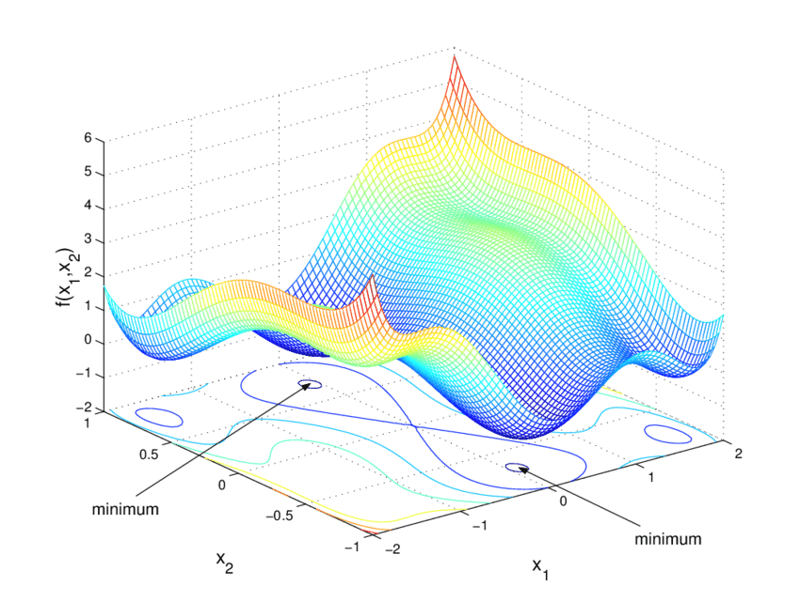
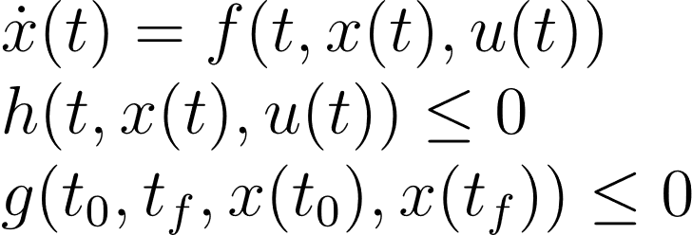
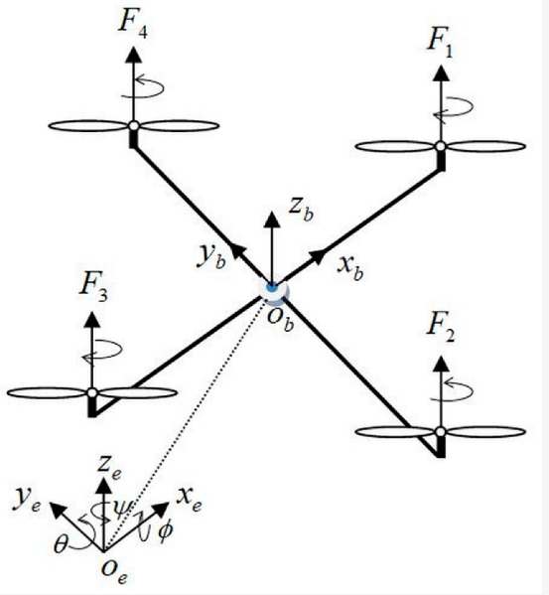
Background (I): Optimal Control Problem
OCPs are posed to find the optimal control input trajectory to minimise an objective function subject to dynamics and mission constraints
Cost
Constraints

Slide 9
Background (II): Setpoint Tracking

Slide 10
Formulation

Slide 11
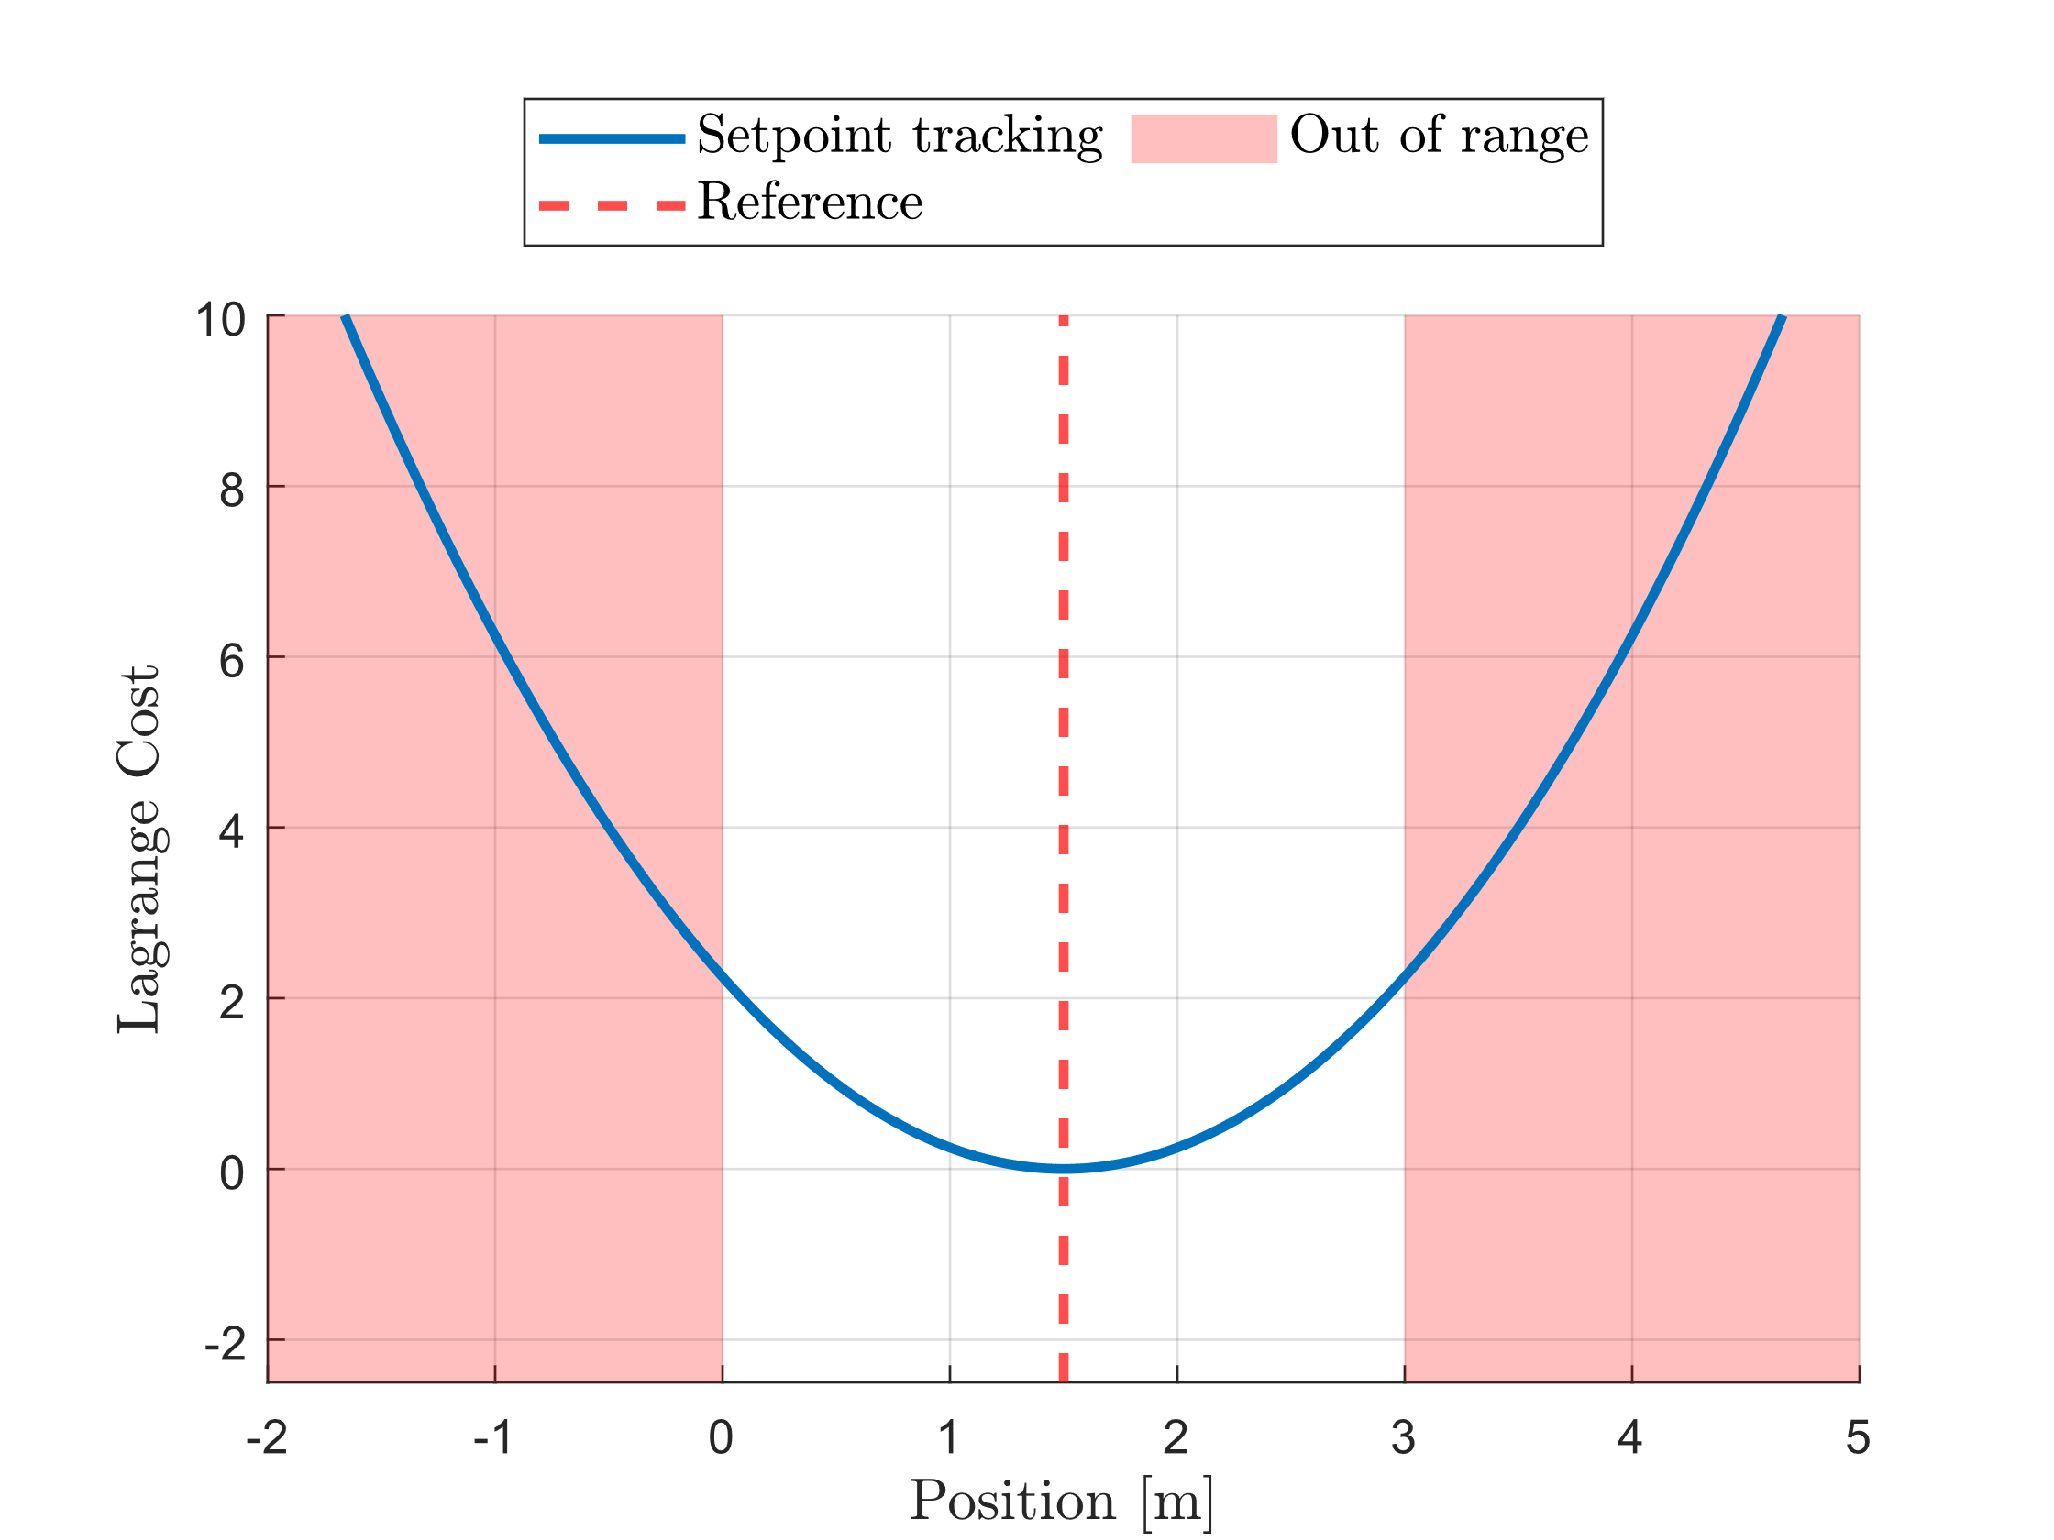
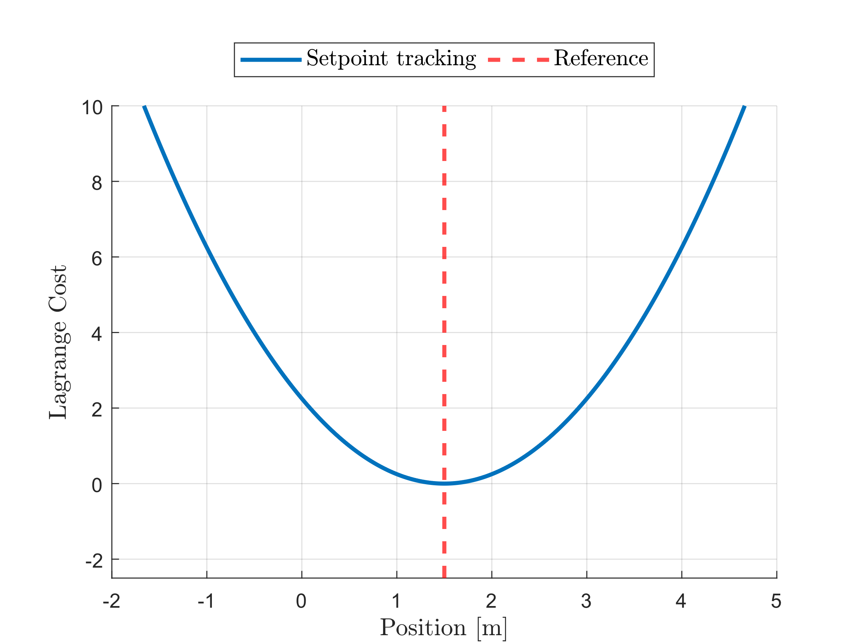
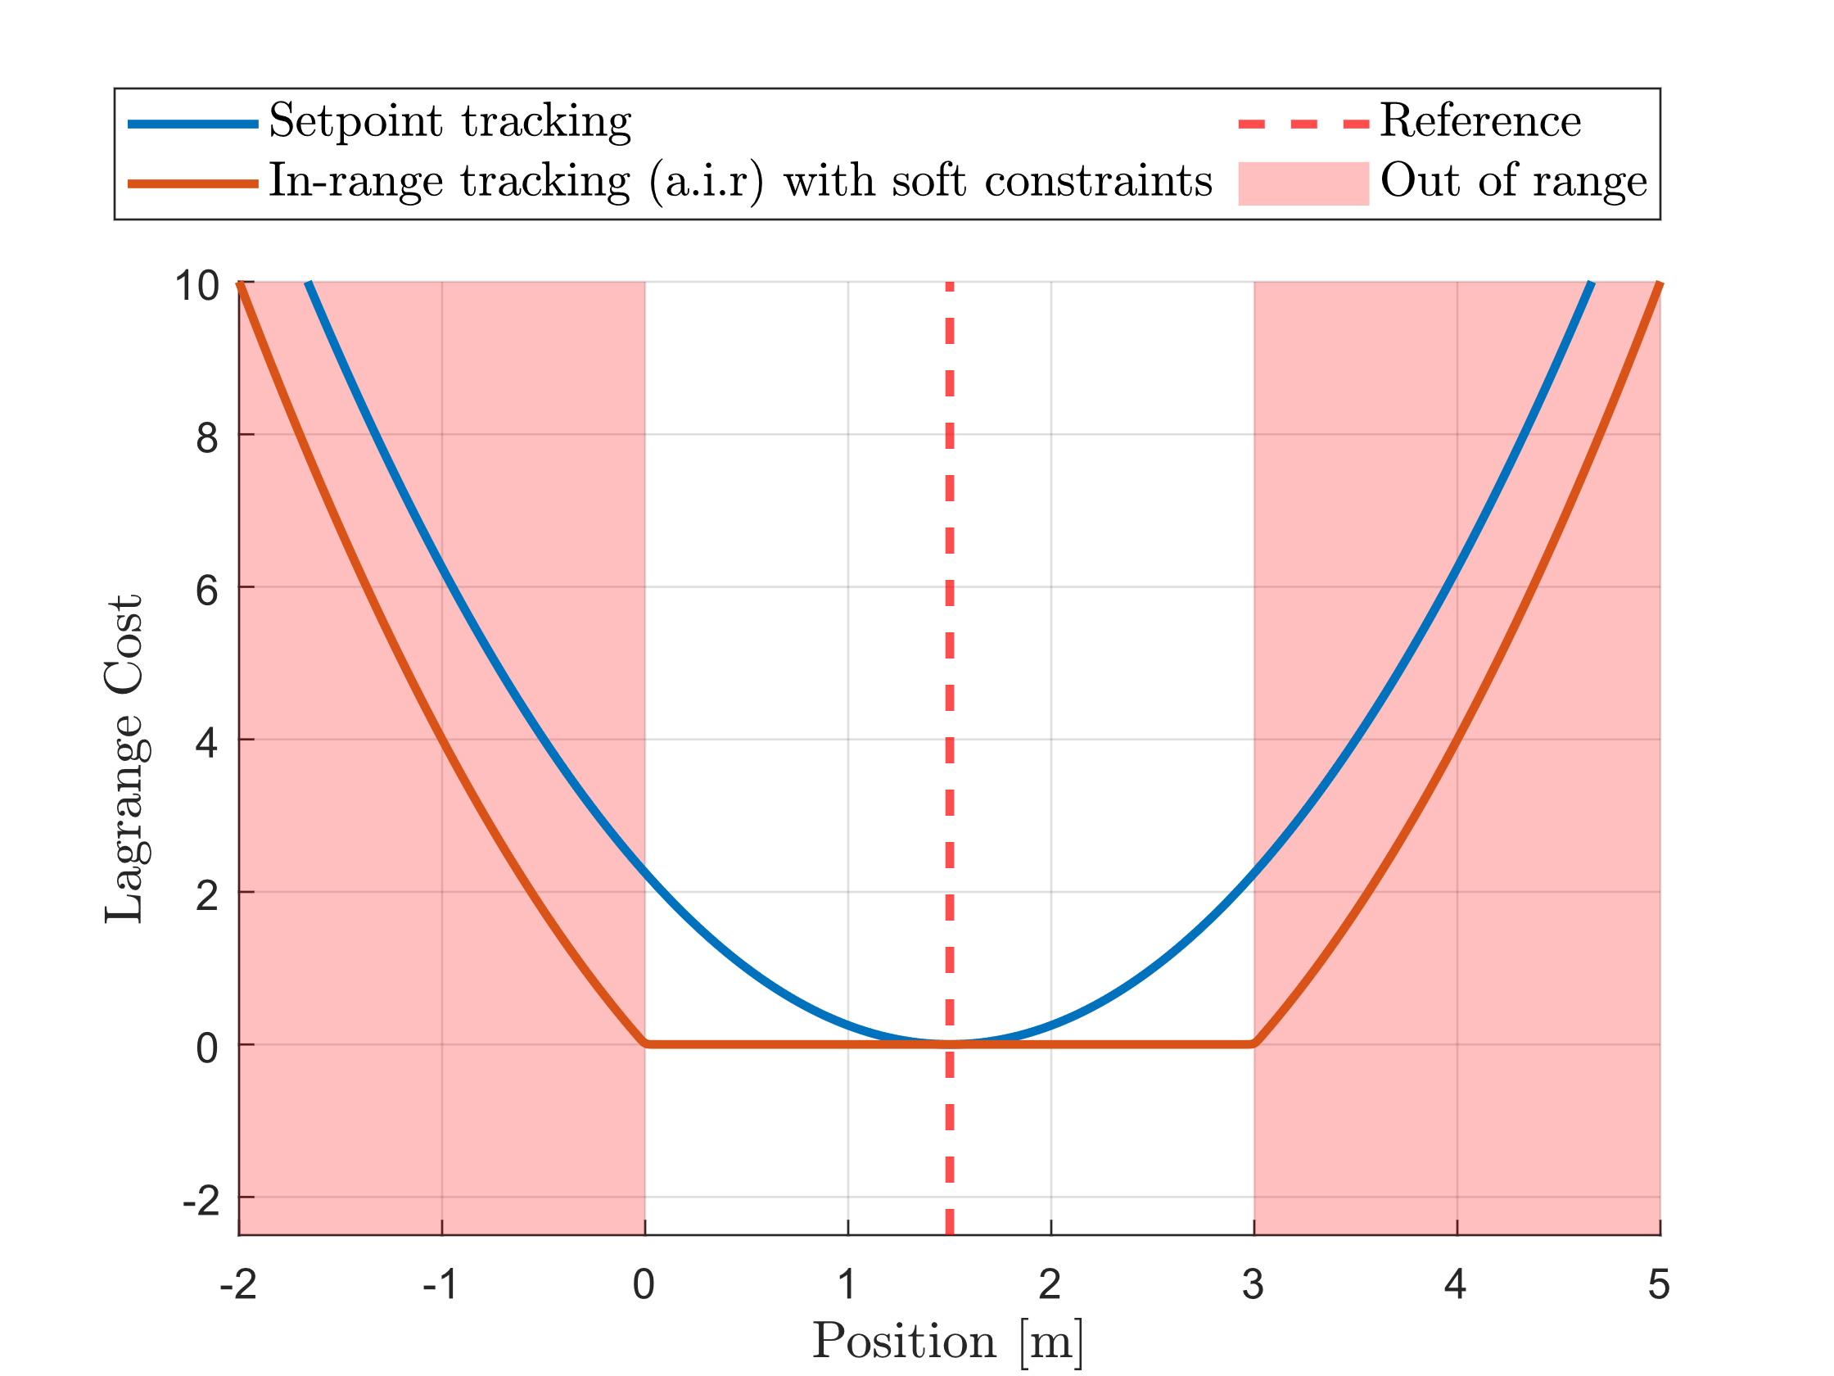
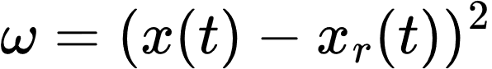
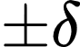
Formulation (I): In-range Behavior
Setpoint Tracking Lagrange Cost
Introduce the range
Always In-range Tracking Lagrange Cost

Slide 12
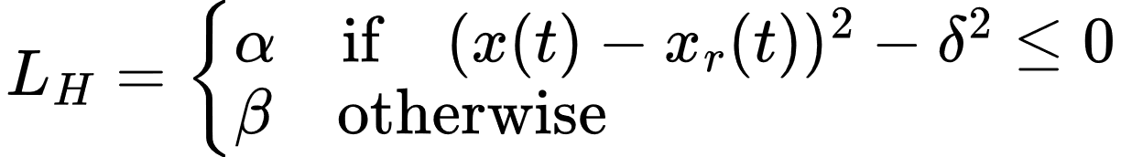
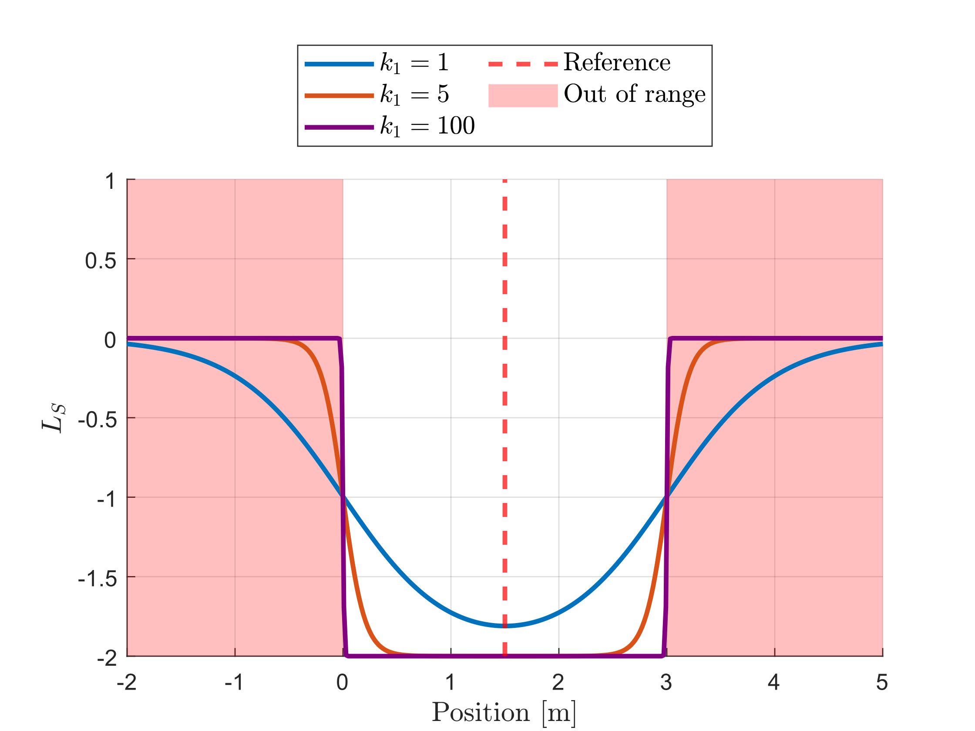
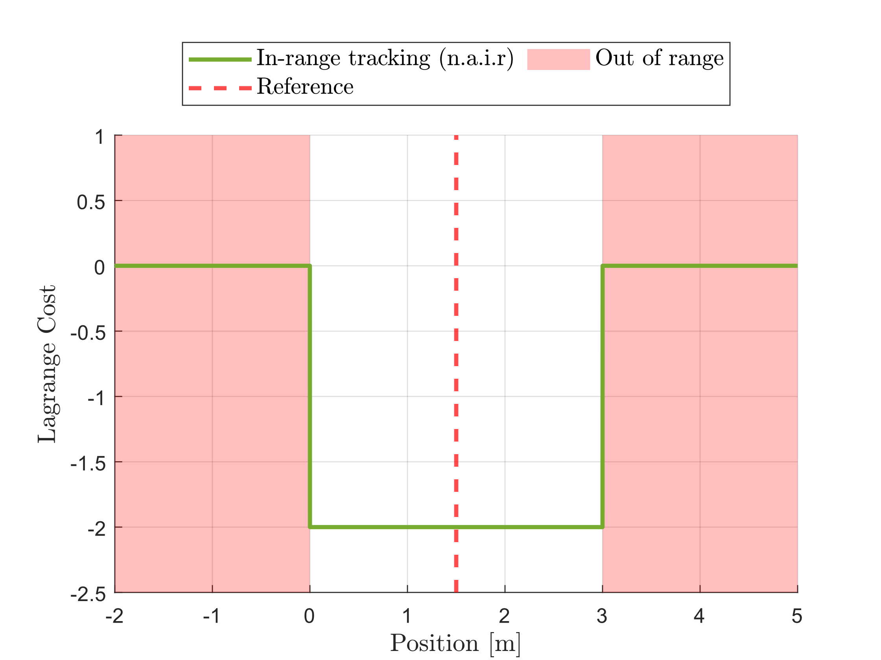
Formulation (II): Out-of-range Behavior
Ideal cost function
Approximate cost function

Slide 13
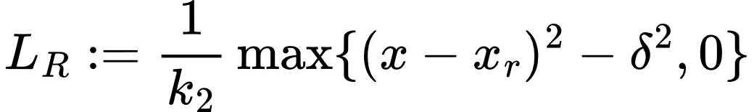
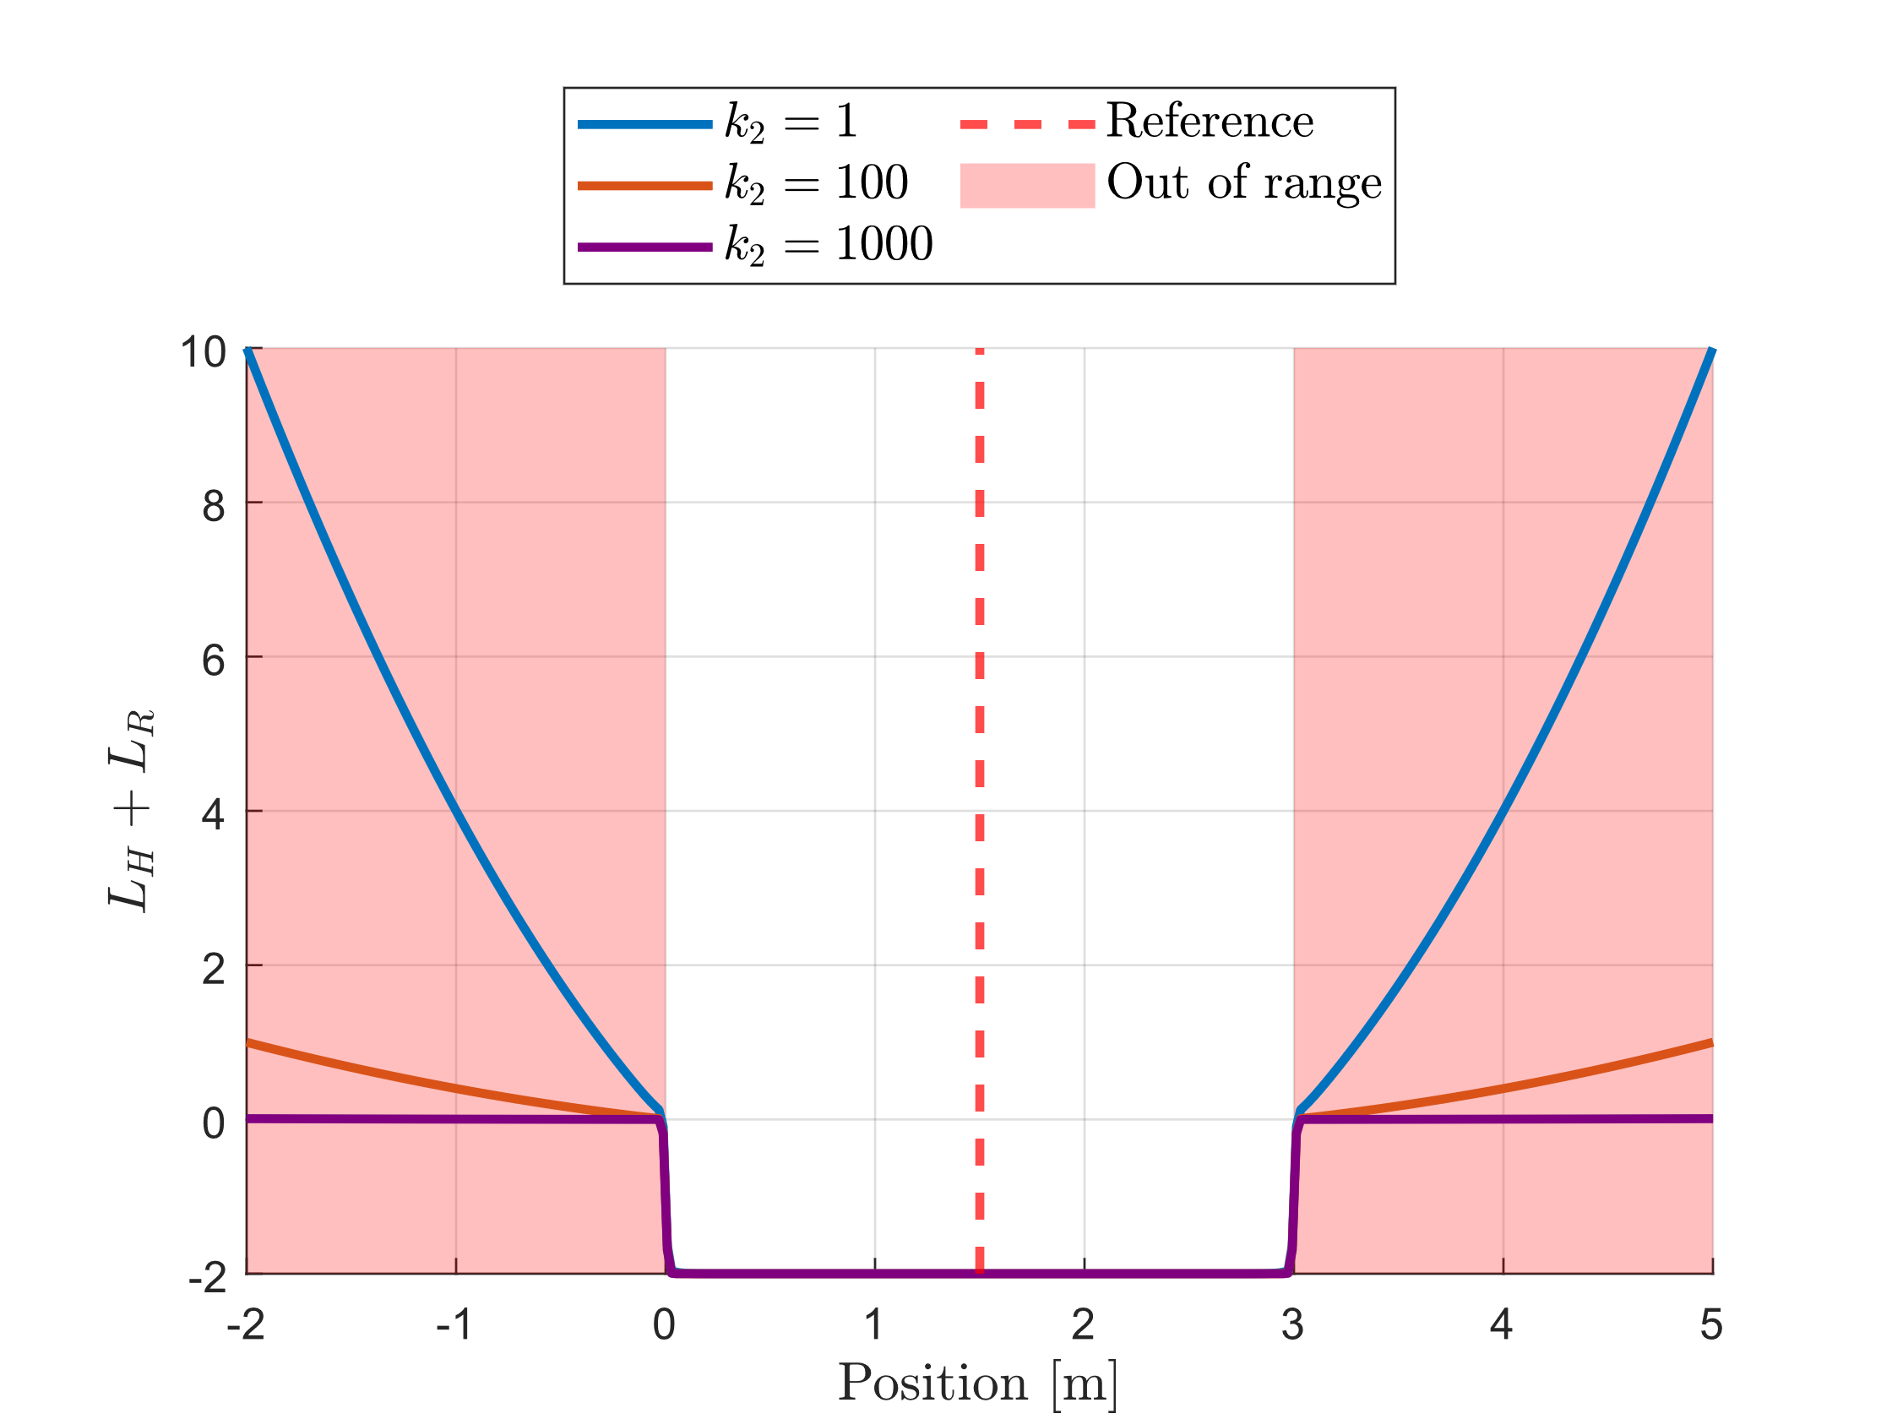
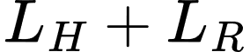
Formulation (III): Regularisation
Introducing regularisation to deal with the lack of gradient information when the tracker out of range.
Small enough to have minimal effects on the overall framework.
After regularisation

Slide 14
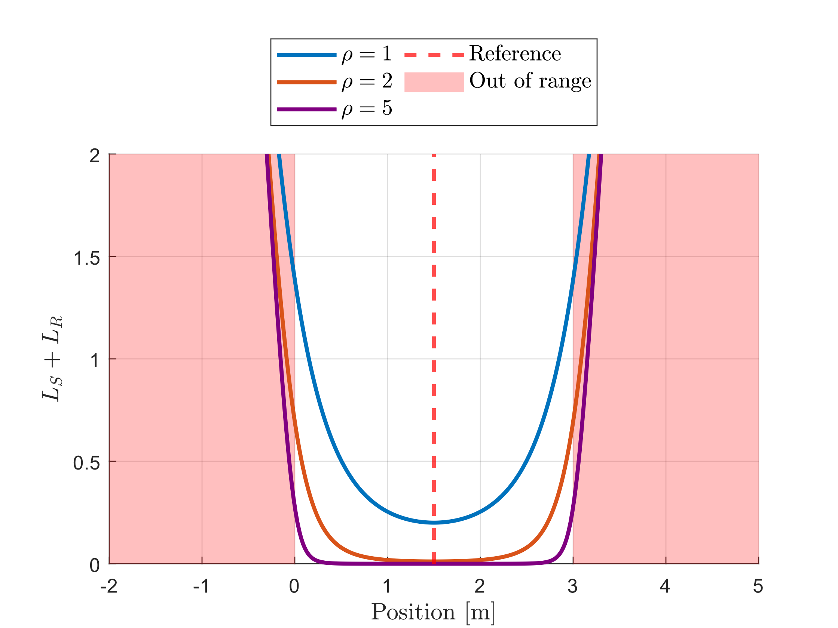
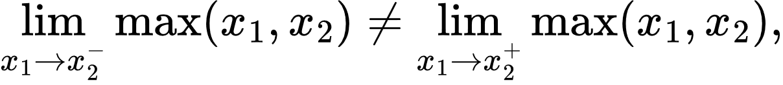
Formulation (IV): Smooth Maximum
Maximum operator is discontinuous
Log-Sum-Exp Function to approximate the maximum operator
Such that

Slide 15
Any questions?
Joe.bloggs@Sheffield.ac.uk

